Slide 1
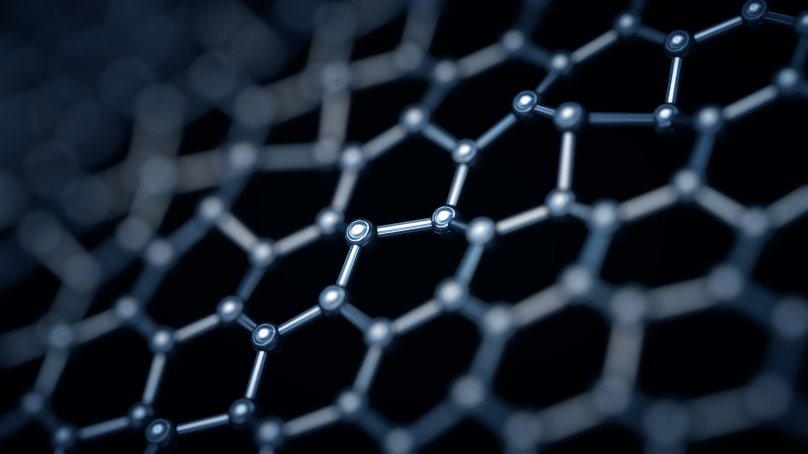
Properties of hard and anti-wear coatings in engineering industry, deposited using chemical and physical vapor deposition methods
Marcin Tomkiewicz

Slide 2
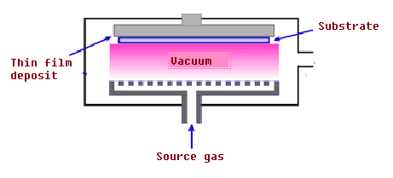
Chemical and Physical Vapour Deposition: a short recap

Slide 3
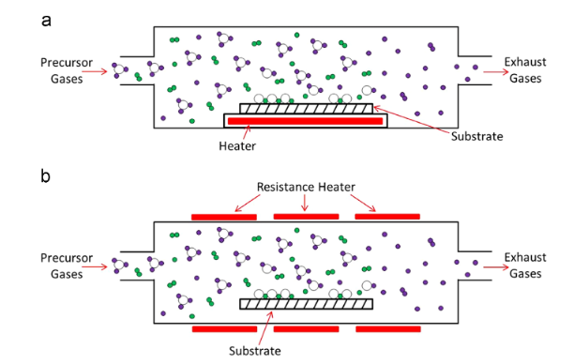
Chemical Vapour Deposition (CVD)
Uses chemical precursors to form a thin film on a substrate
Precursor reacts or decomposes on the surface of substrate
Can be used to deposit wide range of stuctures from amorphous to epitaxial
Notes:
Chemical vapor deposition (CVD) techniques are based on the use of chemical precursors to form a thin film on a substrate by reacting in an isolated chamber. CVD techniques can be divided in groups according to the method used to activate the chemical precursors
Chemical vapor deposition processes are widely used in industry because they deposit a wide range of elements and compounds in a number of structures, from amorphous to epitaxial. Which means that it has the same structure as a substrate. In a CVD process, the chemical volatile precursors reacts or decomposes (or both) on the surface of the substrate, in order to generate the desired thin film [125]. The process of activating the precursors defines the type and the character- istics of the chemical vapor deposition techniques

Slide 4
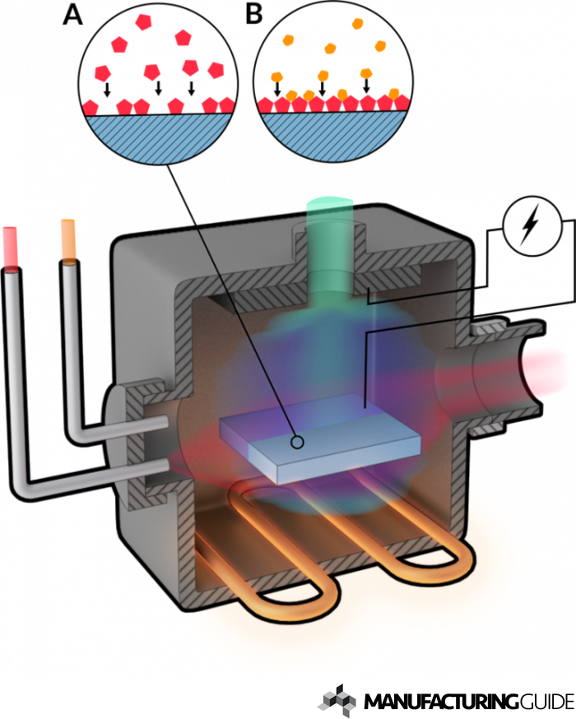
CVD techniques
Atmospheric pressure (APCVD) - a method using normal pressure, very competitive from price point of view
Low pressure (LPCVD) - uses pressure lower than atmospheric, which results in higher velocity of transport and reaction
Plasma activated or Plasma enhanced (PACVD/PECVD)
Notes:
Atmospheric Pressure Chemical Vapour Deposition is a CVD method at normal pressure (atmospheric pressure). Which is used for deposition of different oxides. An atmospheric pressure chemical vapor deposition (APCVD) system uses atmospheric pressure or 1 atm in the reaction chamber.
APCVD is compatible with vacuum free, continuous in-line processes, making it very attractive for cost sensitive, high volume manufacturing applications like PV cell manufacturing.
High Temperature APCVD process used to deposit epitaxial Si and compound films in cold wall reactor or hard metallurgical coatings like TiC and TiN in hot wall reactor.
LPCVD is similar to conventional CVD, but the lower pressure is its only distinguishing parameter. The main advantage of lower pressures is the ratio of the mass transport velocity and the velocity of reaction on the surface, while the major drawback is that LPCVD can only occur at high temperature
The issue of the high temperatures required by thermal CVD and low pressure CVD can be overcome with the introduction of plasma-based techniques in CVD systems. In these situa- tions, gas phase chemistry can be used because the energy comes from a plasma discharge rather than a thermal source, as in high temperature processes. During a plasma-based chemi- cal vapor deposition, the vapor phase constituents react to form a thin solid film, thanks to an electric discharge, and involve temperatures typically lower than 300 1C. Plasma has a twofold role: it enhances the formation of compound films by activating the reactions between the evaporating metal species and the reactive gas; and it modifies growth kinetics, structure, morphology and therefore the physical properties of the final coating
Plasma-based CVD is widely known as plasma enhanced CVD (PECVD), or plasma activated/assisted CVD (PACVD) [146]. The name ‘plasma induced CVD (PICVD)’has also been used [147]. PECVD allows homogeneous coatings to be applied on objects with complicated shapes, while ensuring high adhesion and good morphology of the layers. Recently, a high power pulsed PECVD (HiPP-PECVD) process has been developed and it is a promising tool for low temperature deposition of films with tailored properties such as those found in the hard coatings industry [146,148]. When the substrate is placed far from the plasma generation zone, or rather not directly subjected to the plasma discharge generated between anode and cathode, PECVD is performed in a remote configuration. This is a more gentle technique owing to the lower degree of particle bombardment [149] and it is frequently used in the CVD process known as atomic layer deposition (ALD)

Slide 5
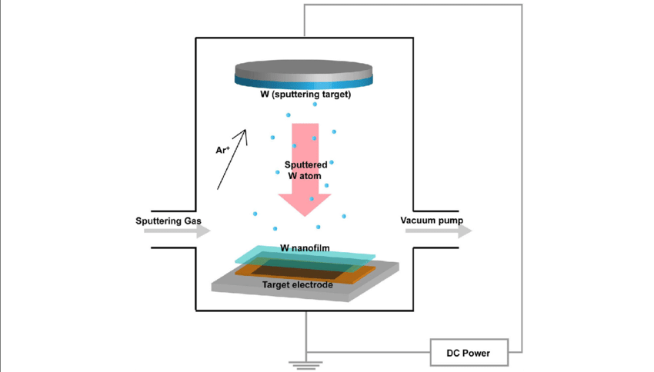
Physical Vapour deposition
Is a set of vacuum deposition methods, in which a solid material vaporizes in vacuum and is deposited on a substrate
There are three main types of PVD: - thermal evaporation, in which heated material condenses on substrate - sputtering, which involves generation of plasma between the coating species and substrate - ion plating, it is basically a combination of the two above
Notes:
Physical vapour deposition (PVD) is a thin-film coating process which produces coatings of pure metals, metallic alloys and ceramics with a thickness usually in the range 1 to 10µm. Physical vapour deposition, as its name implies, involves physically depositing atoms, ions or molecules of a coating species on to a substrate.
Physical Vapor Deposition (PVD) is a set of vacuum deposition methods in which a solid material vaporizes in a vacuum environment and is deposit on the substrate as a thin film. The most common methods of PVD are Sputtering and Thermal Evaporation. Because in the PVD process, the material is transported and accumulated atom-by-atom or molecule by molecule in a vacuum to the substrate surface, the deposited films have high purity and efficiency that for many applications compared to other deposition methods are preferred.
Thermal evaporation uses the heating of a material to form a vapour which condenses on a substrate to form the coating. Heating is achieved by various methods including hot filament, electrical resistance, electron or laser beam and electric arc.
Sputtering involves the electrical generation of a plasma between the coating species and the substrate.
Ion plating is essentially a combination of thermal evaporation and sputtering.
All three techniques can be used for the direct deposition of a material or for 'reactive' use in which chemical reaction occurs in the vapour/plasma phase between atoms of the coating material and 'reactive' gases.
The temperature of the substrate being coated is typically in the range of 200-400°C, considerably lower than temperatures associated with CVD (chemical vapour deposition, the other thin-film process). PVD is a line-of-sight process and requires the substrate surface to be easily accessible. Some components are rotated to produce even coatings.
PVD is a batch coating process with typical cycle times of 1 to 3 hours, depending on the material being deposited and the desired coating thickness. Common coating rates are 50 to 500µm/hr depending on the technique. Coated components do not require additional machining or heat

Slide 6
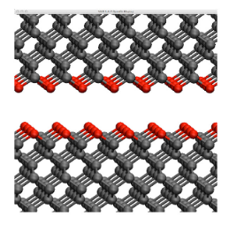
Diamond and Diamond-like Carbon coatings

Slide 7
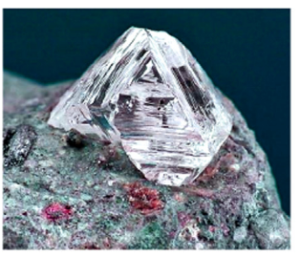
Diamond films
Polycrystalline diamonds (PCD) are much cheaper and easier to manufacture cousins of natural bulk diamonds
One of the most common methods of fabrication of diamond films are CVD methods like microwave CVD
Research work on diamond films exploded in 1980s and 1990s, with methane gas in presence of hydrogen method being the major breakthrough
Notes:
tural bulk diamonds are very difficult to machine or manufacture into special shapes or forms for practical applications. They are also cost-prohibitive and hence used very rarely for wear applications. Instead, much cheaper synthetic polycrystalline diamonds (PCD) are produced using high-pressure, high-temperature synthesis methods in fine power forms and then sintered into useful shapes or inserts for a variety of machining and grinding applications.
the production of microcrystalline diamond (MCD) as thin films had finally been realized from the low pressure methane gas in the presence of hydrogen. Since these groundbreaking studies, research work on diamond films has exploded during the 1980s and 1990s and as a result, the production of high-quality (or highly crystalline) diamond films were realized using a variety of CVD tech- niques [13,18,31,32]. This was certainly a major breakthrough in the field of super-hard materials and coatings
At present, the deposition of high-quality MCD films has become a routine operation using a variety of CVD methods. Fig. 2 shows gem quality natural diamond and its thin film forms produced by CVD methods. Some of the most common deposition methods in use today include hot-filament CVD, microwave CVD, combustion flame, DC-arc jet, laser assisted, hydrothermal growth, etc.

Slide 8
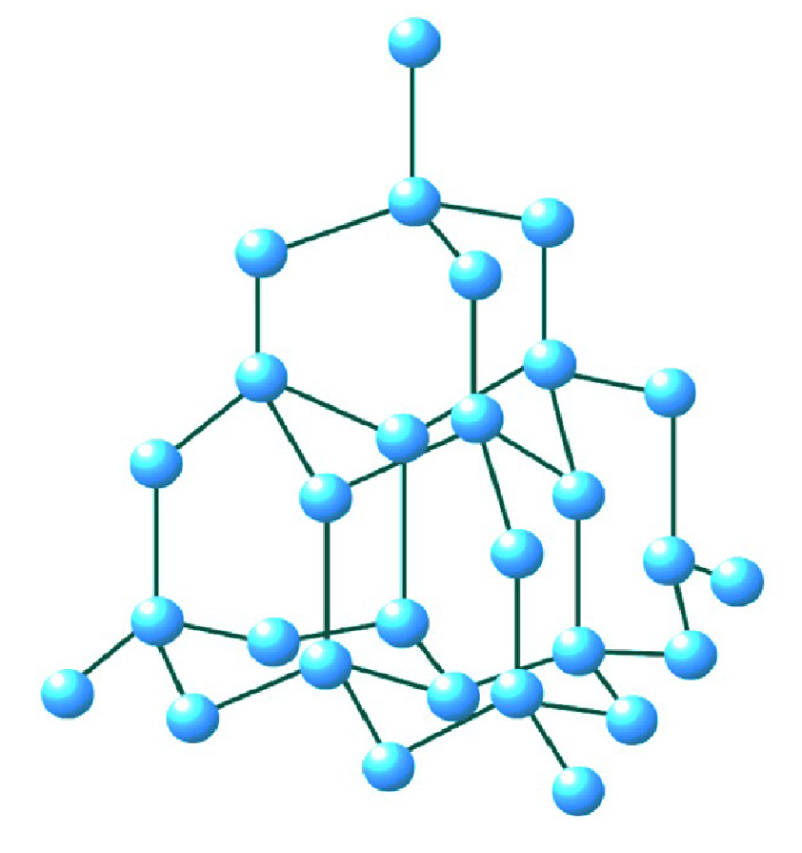
Diamond films
CVD deposition of PCD layers takes place with gas composition of 0.5-5% methane, over 95% hydrogen and other gasses
Conditions lead to nucleation of sp3 carbon. Highly energetic hydrogen etches other phases and stabilizes only sp3 bonding in diamond film
Other gasses are used to introduce N, P, or B atoms to achieve better optical, or electrical properties
Notes:
A typical operating gas composition for microwave CVD as an example contains about 0.5–5% methane and 95–99.5% hydrogen. Small amounts of other gases (i.e., oxygen, nitrogen, and halogen, and other precursor gases) may also be blended to help etch out the non-diamond phases and/or to introduce N, P, and B atoms into the growing diamond films to achieve better optical and/or electronic properties. The deposition temperature could be as high as 1000 °C which leads to the initial formation of sp3-bonded diamond precursors that act as the nucleation points on underlying substrates. Highly energetic hydrogen ions and atoms continuously etch those phases other than diamond and stabilize only the sp3 bonding in the growing diamond film. It also facilitates the creation of open sites to which the next rounds of carbon atoms can attach with sp3 bonding and thus leads to the synthesis of a highly crystalline, phase-pure diamond film.

Slide 9
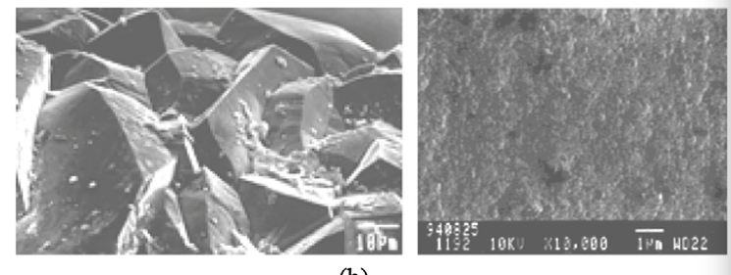
Microcrystalline diamond (MCD) and Nanocrystalline diamond (NCD)
Highly crystalline MCD are generally made of wide and long columnar grains with peculiar preferred growth orientations
Typical rms roughness of it is typically around 10% of film thickness
Nanocrystalline diamond grain side varies around 10-100 nm, thus making a surface much smoother
Notes:
Phase-pure and highly crystalline MCD films are generally made of wide and long columnar grains with very peculiar preferred growth orientations leading to a highly-faceted and hence very rough surface finish (as in Fig. 2b) which can cause severe abrasion during sliding contacts [6,37,38]. In fact, the thicker the film, the rougher the surface finish with a typical rms surface roughness of ≈10% of the film thickness. The rough diamond films can be polished to achieve a very smooth surface finish using laser beams, ion-beam or plasma etching, mechanical lapping with fine diamond particles, and thermomechanical polishing with hot iron plates [39]. After rigorous polishing, it is pos- sible to achieve an ultra-smooth surface finish on MCDs and then the friction and wear properties become comparable to those of natural diamonds [40–42]. However, from an industrial application point of view, the mentioned polishing methods tend to be very slow (take very long time to get rid of all the asperities) and in the case of complex geometries, some of the polishing methods may not be practical. This is perhaps one of the key reasons that rough diamond films have not found many sliding tribological applications as they can trigger severe abrasive wear.
Realizing the handicaps of MCD films for tribological and other engineering applications, researchers have developed new deposition procedures and/or conditions that can reduce grain size and hence surface roughness [18,45]. Typical grain size of NCD films may vary between 10 and 100 nm and their surface roughness may range from 10 to 50 nm RMS [45–47]. These films are synthesized by creating con- ditions that favor very high nucleation densities during deposition such as using nanodiamond particles as seeding purposes. As a result, their surfaces are much smoother and the film structure is made of highly crystalline columnar grains of 10–100 nm wide. Deposition of NCDs is done at around 900 °C and the typical gas composition could be 0.1–1% CH4 and 99.9–99% H2

Slide 10
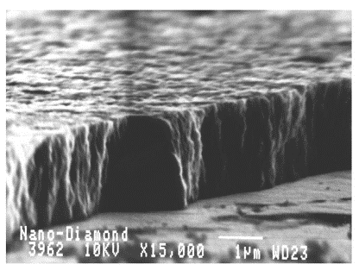
Friction wear of diamond films
Thanks to C-C bonds, diamond is the hardest and strongest material
Bulk crystal can have friction coefficient as low as 0.02 and no measurable wear
But diamond tribology can be very complex, especially in severe conditions
Furthermore, diamonds can be chipped or cracked along the weak {111} planes, or chemically dissolved f. ex. with hot iron plates
Notes:
arbon atoms that constitute diamond’s cubic crystal structure are covalently bonded to one another with shortest bond lengths in a highest packing density. This unique combination makes diamond the hardest and the strongest material of all. Diamond has also the highest Young's modulus, thermal conductivity (at room temperature) and the chemical inertness. Owing to such impressive array of outstanding properties, many experimental studies have shown that bulk diamonds are literally indestructible under most ordinary mechanical sliding conditions
Friction of diamond was also reported to be very low due to its very high chemical inertness and smallest contact sizes afforded by its ultra- incompressible nature. For bulk or single crystal diamonds, Bowden and his coworkers have confirmed that the friction coefficients in open air could be as low as 0.02 with no measurable wear [55–57]. However, past experiments have also shown that diamond’s tribology could be rather complex especially when test conditions and/or environments become severe; i.e., inert or vacuum environments, high temperatures and contact pressure
Furthermore, diamond can be chipped or cracked along the weaker {1 1 1} cleavage planes. In fact, earlier fundamental studies have confirmed that crystallographic or- ientation of diamond in coatings can have a significant impact on wear resistance [54] but in most diamond coatings (especially the nano-to- ultrananocrystalline diamonds), these effects are essentially absent.diamond tends to be very prone to chemical dissolution when in contact with hot iron plates (which was often used for polishing diamond in the past).

Slide 11
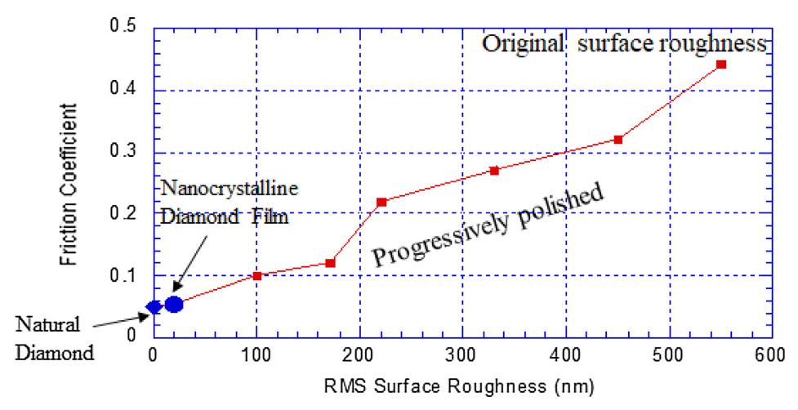
Surface roughness
Generally rougher surface causes high friction and high wear loses
Rough film can cut or scratch soft surfaces (steel) or induce micro-cracking in hard materials (ceramics)
Sliding against smooth diamond layer can cause a layer of amorphous or graphite carbon, which can be transferred to the mating surface
Ultra-smooth NCD can have friction coefficient while non-polished MCD can have over 0.7
Notes:
Depending on the type of diamond films, the surface roughness may vary a great deal. As a rule of thumb, previous research has confirmed that the rougher the surface finish, the higher the wear losses [37,38,40,41,59–61] as shown in Fig. 4. As a rule of thumb, rough surface finishes always causes high friction (regardless of the test environments
specifically, a rough microcrystalline diamond film like the one shown in Fig. 2, can easily cut or scratch mating surfaces (especially softer counterfaces, like steel) and thus cause severe abrasion (especially if the mating surfaces are made of softer materials, like steel). In the case of brittle materials like ceramics, sharp edges can cause micro-cracking under the influence of highly concentrated stresses and thus give rise to material removal. Repeated sliding passes over the same contact area may also trigger micro-fatigue events away from the contact spots and thus weaken the structure and further accelerate the wear process.
When sliding against smooth diamond films, most often a tribo-
chemically-induced transfer layer can form on the sliding counterface
surfaces. These layers are in the form of amorphous carbon or dis-
ordered graphitic carbon and eventually, the sliding contact largely
occurs between the transferred graphitic layer and the original diamond
Recently reported friction values for
ultra-smooth nanocrystalline or polished diamond films could be as low
as 0.01 in humid air, while for rough microcrystalline films are as high
as 0.7

Slide 12
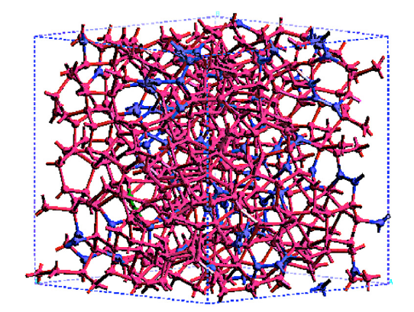
Diamondlike carbon (DLC) films
DLCs are structurally amorphous and are produced in much lower temperatures
There are numerous deposition methods i. e. arc-PVD PECVD
Depending on method they can be hard and diamondlike or soft and graphitelike
Ratio of sp3/sp2 decides linearly of hardness of films, with typical 70% for hard films
Notes:
Unlike diamond, DLC coatings are structurally amorphous and can be produced more conveniently at much lower temperatures (i.e., room temperature to about 300 °C) and deposition rates. There exist nu- merous deposition methods (i.e., DC and RF sputtering, arc-PVD, plasma-enhanced CVD, pulsed laser deposition, ion-beam deposition, etc.) that can be used to produce these films from all kinds of hydro- carbon gases (such as methane, acetylene, ethylene, cyclohexane, etc.). Ta-C DLCs are synthesized using solid carbon targets in argon gas dis- charge plasmas using arc-PVD, pulse-laser deposition, and ion-beam
Unlike diamond, DLC coatings are structurally amorphous and can
be produced more conveniently at much lower temperatures (i.e., room
temperature to about 300 °C) and deposition rates. There exist nu-
merous deposition methods (i.e., DC and RF sputtering, arc-PVD,
plasma-enhanced CVD, pulsed laser deposition, ion-beam deposition,
etc.) that can be used to produce these films from all kinds of hydro-
carbon gases (such as methane, acetylene, ethylene, cyclohexane, etc.).
Ta-C DLCs are synthesized using solid carbon targets in argon gas dis-
charge plasmas using arc-PVD, pulse-laser deposition, and ion-beam
ta-C coatings have an amorphous structure and
are made of a network of sp2 and sp3-hybridized carbon atoms.
Typically the sp3/sp2 ratio lies between 40 and 70% corresponding to
soft and hard ta-C, respectively. If the sp3/sp2 ratio is below 40%, the
material is called a-C and the hardness is much lower (say about 25
GPa)), even if it is much higher than hardened steel (i.e., 7–8 GPa). In
hydrogen-free carbon material, it is known that the sp3/sp2 ratio varies
linearly with the density of the material and then with the hardness.
n this case the sp3/ sp2 ratio is about 70% corresponding to a density of 3.24 g/cm3 (dia- mond is 3.54 g/cm3 and graphite is 2.26 g/cm3), the percolating sp3 network is associated with isolated sp2 carbon and a few sp1 units. The corresponding hardness is estimated to be 60 GPa depicting a hard ta-C material.

Slide 13
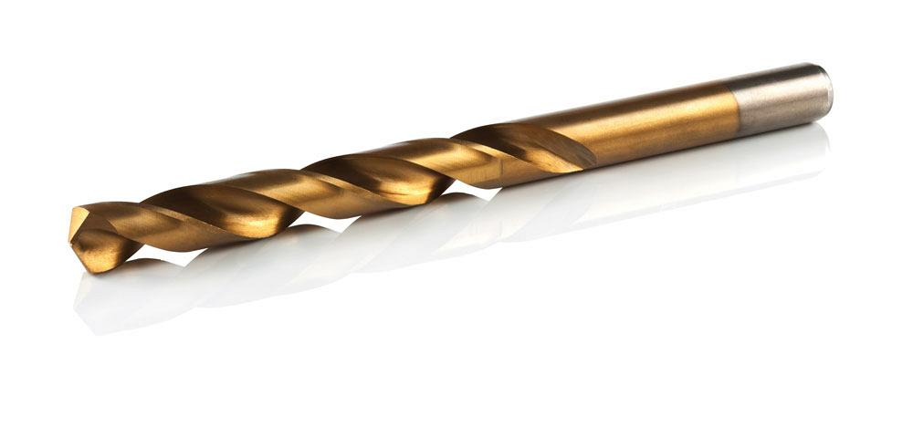
Titanium Nitride based coatings

Slide 14
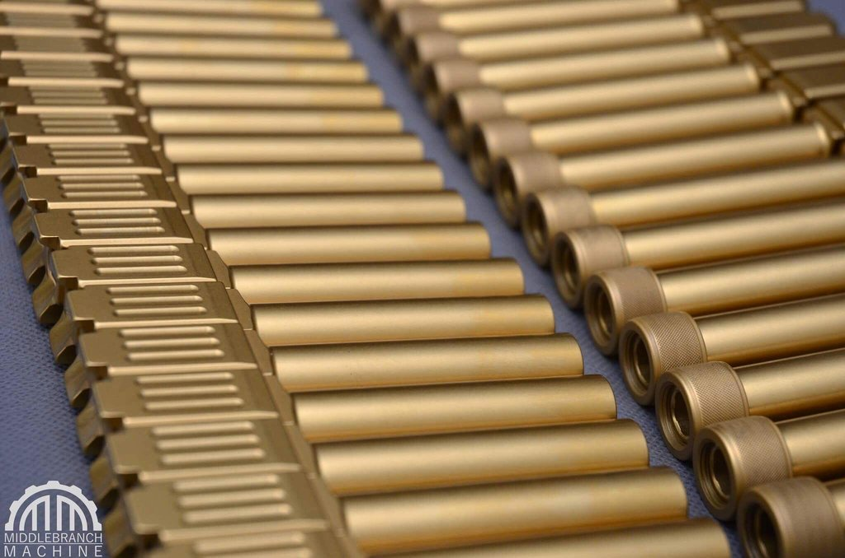
Titanium Nitride
Hard and versatile ceramic material
Base for further development of the whole family of materials
Has a basic NaCl cubic structure, which is stable in a broad stoichiometry (from 0.6-1.2 of N) with the highest hardness at N to Ti ratio of 0.8 (30GPa)
The main drawback is an oxidation of nitride at relatively low temperature (500°C)
Notes:
Titanium nitride and carbide coatings deposited by sputtering are stable over a wide chemical composition range but their structure and properties are strongly depend- ent of their divergence from stoichiometry [81,82]. Cubic TiN^^. is stable over a broad composition range (0.6 ^ x ^ 1.2) and appreciable vacancy concentrations (up to 50at.%) [83]. The TiN phase, indexed to a NaCl structure, has at the stoichio- metric composition a lattice parameter of 0.4240 nm. Besides the chemical compo- sition, also the thermal expansion coefficients mismatch between the coating and the substrate, which causes stresses in the coatings, can promote a shift in the lat- tice parameter value. Additionally, the lattice parameter deviations can be due to the presence of impurities in the structure; while oxygen induces a decrease, carbon and nitrogen originate an increase of the lattice parameter; and argon, generally, induces high values of residual compressive stress in the sputtered coatings causing a significant change in the lattice parameter (up to 1 at.% of argon can be trapped in TiN coatings)
The compressive residual stress of the titanium carbide and titanium nitride coat-
ings are extremely high, achieving values of 8 GPa [88,89] being almost independent
of the substrate bias [89] and increasing as the non-metal to titanium ratio approaches
to the stoichiometric composition [90]. These values may result from the high density
of grain boundaries and defects in TiC and TiN thin films, decreasing the mobility
of the dislocations. The stress state could be more favorable if the morphologies were
columnar. The highest hardness of the TiN are found on coatings with nitrogen to tita-
nium ratio of approximately 0.8, attaining values of 30 GPa. For over-stoichiometric
coatings, hardness drops abruptly to values of 3.5 GPa
In spite of the wide range of applications of TiN coatings, they present some dis- advantages, mainly the oxidation at relatively low temperatures ~500°C. Therefore, the role of oxidation is very important for practical applications and has been sub- ject of several studies

Slide 15
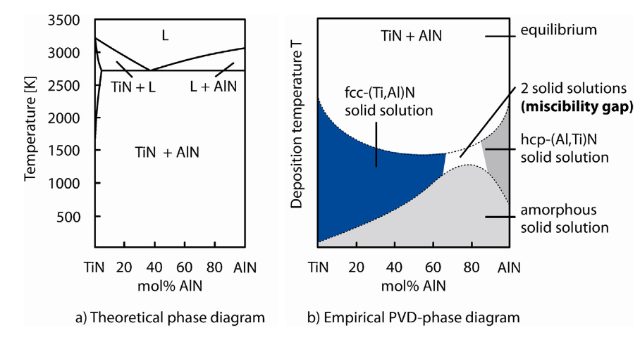
Titanium-Aluminium Nitride
Theoretical solubility of tetragonal AlN in TiN is none, but it is possible to produce fcc solid solution of Al in TiN
Hexagonal phase leads to deterioration of mechanical properties and prevention of it is a goal in TiAlN coatings
The main advantage over TiN is an improvement of oxidation stability
The oxide layer is not only alumina, but titanium oxide as well, so it has limited capabilities
Notes:
A solubility between TiN, which is cubic, and AIN, which is hexagonal, does in theory not exist (Fig. 6a). Nevertheless, it is possible to produce ternary solid solutions by means of an activation of the plasma at a suitable coating temperature. The cubic phase, which is the preferred phase for machining, can be stabilised up to an AIN content of approximately 63% [46], depending on the coating process (Fig. 6b). The occurrence of the hexagonal phase leads to a significant deterioration of the mechanical properties. Therefore, it is tried to be prevented. Solid solution strengthening is caused by a substitution of Ti atoms with Al atoms within the kfz grid of the TiN. This is due to the lattice distortion. With an increase of the Al content, the coating hardness tends to increase. Therefore, PVD coatings with a high Al content and a kfz structure will on occasion be offered as AlTiN. AlTiN has also been successfully produced as a result of further development of the CVD processes [47–49]. It has been in offered as a tool coating since 2011
he passive layers on TiAIN which are responsible for the oxidation protection are in fact not pure Al2O3 layers; they are mixed oxides of TiO2 and Al2O3. In contrast to aluminium, titanium does not form protective oxides. Oxygen ions (O2/span>) can diffuse through TiO2 [50] and thus impede the self-healing effect of the oxide layer. The higher the Al content of the TiAIN coating gets, the more effective the oxidation protection becomes. This in turn has a positive effect on the thermal stability of the coatings. A failure of the oxide layer causes a rapid decrease of hardness. This is due to the progressive oxidation of the coating material after being exposed to heat treatment in atmosphere

Slide 16
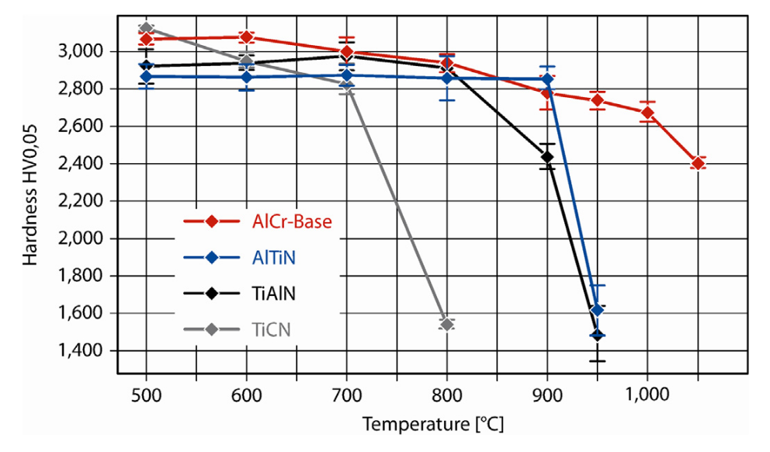
Chromium-Aluminium Nitride
Chromium produces a protective oxide, just like aluminium
Replacing titanium with chromium improves high temperature oxidation resistance
Resistance to oxidation can be further improved by doping these systems with silicon
Notes:
Once more, material-related knowledge on high-temperature alloys supplies an obvious solution: chromium as well forms a protective oxide layer which possesses a reliable barrier to prevent the infusion of oxygen ions. By replacing TiAIN with CrAIN, the oxidation resistance can be further increased [54]. Even though this has been known for a long time and although in the 1990s CrAIN has been sufficiently investigated concerning this matter (e.g. in [51– 53]), the market launch of AlCrN as a tool coating was not until 2003, when due to rising cutting temperatures, the oxidation resistance became more and more important. Amongst others, AlCrN and AlCrSiN is nowadays successfully employed on hobs
This can be accomplished for instance by means of a Si doping of classic systems to TiSiN, TiAlSiN or CrAlSiN, whereby Si and N form the matrix. Here, nanocomposites possess an astonishing high- temperature strength and oxidation resistant [29,67,68,79], due to the nanostructure and Si is the third and last element forming protective oxide layers.

Slide 17
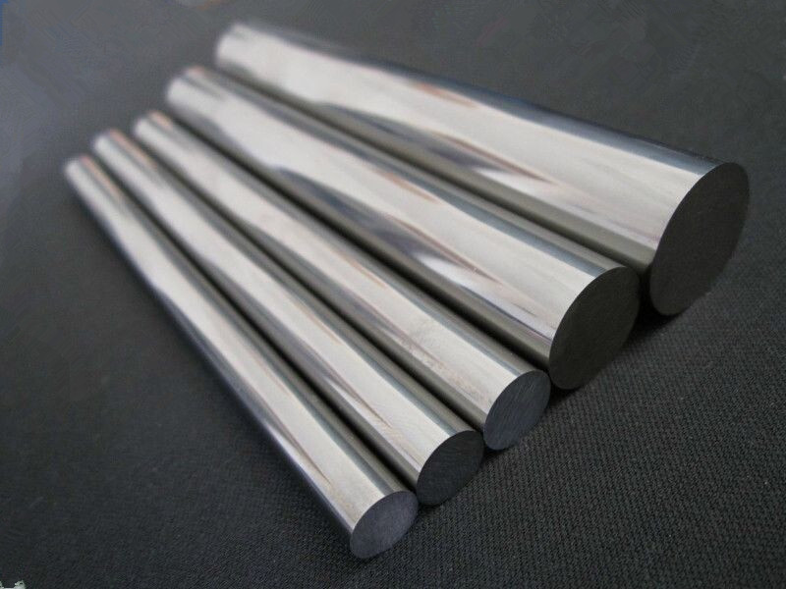
Titanium Carbides
Carbon frequently substitiutes nitrogen in TiN-like coatings
TiC has higher Young's modulus (500 vs 260 GPa), but in coatings, thanks to different morphology, TiN can have Youngs modulus of over 500 GPa
TiC's oxidation starts as low as 400°C, which is attributed to higher defect structure, which is more permeable to the diffusion
Notes:
oncerning the Young's modulus, the titanium carbide attains
values around 500 GPa and the titanium nitride only 260 GPa [3,91,93]. In fact these
results are in agreement with the relative strength of the TiN and TiC chemical bond-
ing, if these coatings have the same morphology. However, some authors pointed
out the opposite [92] with titanium nitride coatings attaining values higher than
500 GPa [88], which could be attributed to different morphologies of the coatings.
TiN coatings exhibit a superior resistance to oxidation in comparison to TiC thin films, whose oxidafion begins at temperatures as low as 400°C [102]. Although, both Ti-based systems present the same rate-determining step of oxidation: diffusion of oxygen through the rutile scale, the TiC films show a substantially higher weight gains then TiN coafings. This behavior was attributed to the higher defect structure of TiC in comparison to TiN structure [102], being more permeable to the diffusion of the reactive species. As nitrogen, also carbon diffuses to the scale surface where it reacts with oxygen to form carbon oxides. Both nitrogen and carbon diffusion must be con- sidered as a possible explanation for the morphologic variations observed in TiN and TiC oxidized surfaces, giving rise to spalling of oxide layer at high-temperature oxidafion

Slide 18
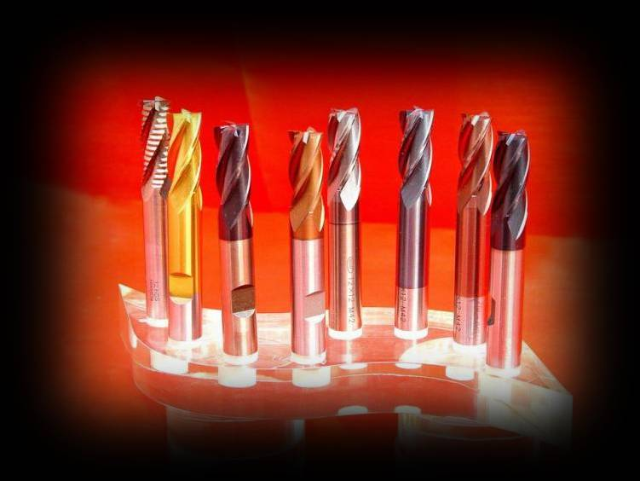
Other hard coatings

Slide 19
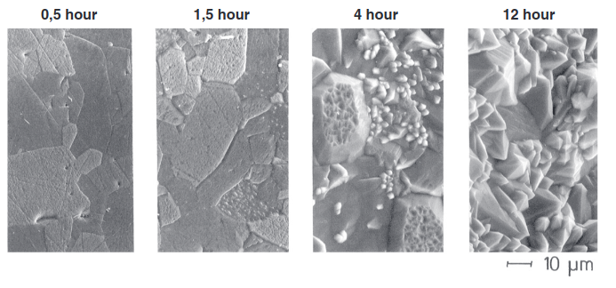
Alumina
This kind of coating can be deposited using CVD processes by substitution of chloride in AlCl3
Alumina coatings present exceptional high temperature and anti-oxidation parameters
However, alumina has low adhesion tendency due to dissimilar types of chemical bonds
Notes:
The tool coating CVD-Al2O3 is in use since 1979. Stable coatings of a-Al2O3 can be synthesised in thermally-activated processes with high-temperatures of T = 1000 8C. The particle size can reach up to a diameter of d = 0.5–1 mm. Smoother Al2O3 coatings are produced in MTCVD processes. Al2O3 crystallises at a mean- temperature (MT) of T <900 8C in the metastable k-phase. The mechanical and thermal properties of those k-Al2O3 coatings are slightly poorer [30]. Yet, due to the smaller particle sizes of d = 50– 100 nm, they are considerably smoother [18]. Then, depending on the application, better cutting results can absolutely be achieved this way. In contact with metals, Al2O3 has a low adhesion tendency due to dissimilar types of chemical bonds. On one hand, this ensures an excellent protection against adhesive wear; on the other hand, however, it prevents a good adhesion on the cemented carbide substrates, which is why Al2O3 coatings are only offered in combination with bond coats. Nowadays, Al2O3-coated cemented carbides are the best-selling products for turning operations [11,31]. Al 2O3-coated tools are a good example to illustrate which performance improvements are possible if cemented carbide production, coating process, and tool geometry are seen as a system specifically designed for application.

Slide 20
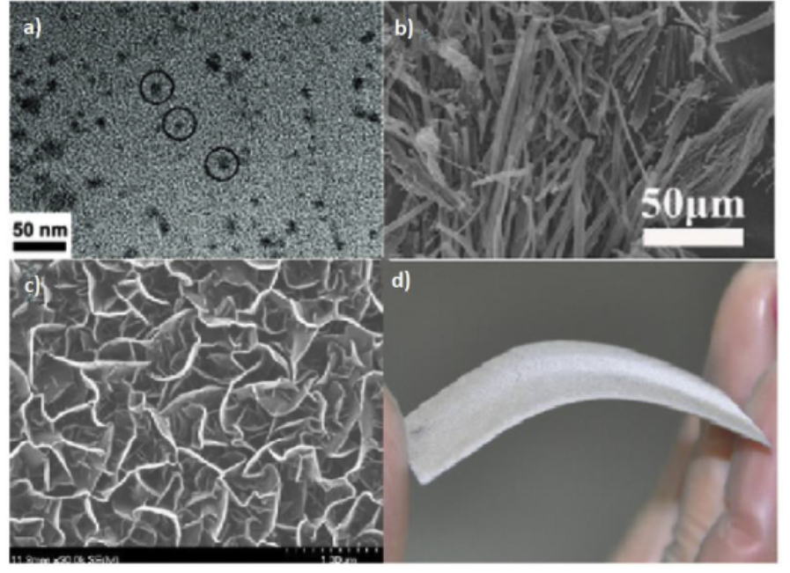
Boron Carbon Nitride
Boron Nitride films have high thermal stability up to 1550°C and Carbon Nitride has a very low friction coefficient
BCN films are considered to have the advantages of both nitrides
Boron Nitride has shown promises, but hygroscopic-related issues have successfully stopped its applications
Adding Carbon to BN solves this issues while retaining superb tribological properties
Notes:
It is established from past researches that boron nitride films have high thermal stability up to 1550 °C [195], and carbon nitride films have low friction coefficient [196,197]. BCN films can be considered having the integrated advantages of both boron nitride and carbon nitride, making it the frontrunner for protective and hard coatings in cutting tools and other such anti-wear applications. Although BN has shown promise in the aspect of low-k applications, its implementation has been crippled due to its hygroscopic nature resulting in a variety of delamination issues [198,199]. However, the addition of carbon to BN to form BCN drastically decreases its moisture sensitivity [53] while still maintaining high hardness values [27,50,161,171,182,200]. Various parameters such as nitrogen content [27,50,161,175], carbon content [173,184,[201], [202], [203]], deposition and annealing temperatures [[204], [205], [206]], and deposition energy [161,171,182,207] have been reported to have a strong effect on the mechanical properties of BCN films.

Slide 21
References
Ali Erdemir et al. "Superior wear resistance of diamond and DLC coatings", published in "Superior wear resistance of diamond and DLC coatings" 22 (2018), pp. 243-256
Ankit Tyagi et al. "A critical review of diamond like carbon coating for wear resistance applications" published in "International Journal of Refractory Metals & Hard Materials" 78 (2019) pp. 107-122
Eleonora Santecchia et al. "Wear resistance investigation of titanium nitride-based coatings" published in "Ceramics International" 41 (2015) pp. 10349-10379
Yves Pauleau et al "Materials Surface Processing by Directed Energy Techniques", book, pp. 537-572
Kirsten Bobzin "High-performance coatings for cutting tools" published in "CIRP Journal of Manufacturing Science and Technology" 18 (2017) pp. 1-7
S. D. Nehate "A review of boron carbon nitride thinfilms and progress in nanomaterials" published in "Materials today advances" 8 (2020)

